Slide 1
Software Design Patterns
Paddy Matthews

Slide 2
Composite Pattern

Slide 3
Composite Pattern
Motivation:
  Allows a group of objects to be treated in the same way as a single instance of an object.
  Without it, we may often need to discriminate between a leaf node and a branch (this makes code more complex, and therefore, error prone).
Intent:
  The intent of this pattern is to compose objects into tree structures to represent part-whole hierarchies.
  Composite lets clients treat individual objects (leaves) and compositions of objects (branches) in the same way.

Slide 4
Composite Pattern
The key concept is that you can manipulate a single instance of the object just as you would a group of objects.
The Composite pattern can be used when clients should ignore the difference between compositions of objects and individual objects.
If you find that you are using multiple objects in the same way, and often have nearly identical code to handle each of them, then Composite is a good choice; it is less complex in this situation to treat primitives and composites as homogenous.

Slide 5
Composite Pattern
Example: Graphics applications like drawing editors and schematic capture systems let users build complex diagrams out of simple components.
The user can group components to form larger components, which in turn can be grouped to form still larger components.
A simple implementation could define classes for graphical primitives such as Text and Lines plus other classes that act as containers for these primitives.

Slide 6
Composite Pattern
The problem with this approach is that the code that uses these classes must treat primitive and container objects differently, even if most of the time the user treats them identically and wants to be able to handle basic components and both basic and nested containers in the same way.
Having to distinguish between these objects makes the application more complex.
The Composite pattern describes how to use recursive composition so that clients don't have to make this distinction.
The key to the Composite pattern is an abstract class that represents both primitive objects and their containers.

Slide 7
Composite Pattern
In the graphic example, we might call this abstract class Graphic.
It declares operations like draw() that are specific to graphical objects, but also declares operations that all composite objects share, such as operations for accessing and managing the composite’s children.
Line, Rectangle, and Text might be subclasses of Graphic that define primitive graphical objects.
These classes implement draw() to draw lines, rectangles, and text, respectively.
Since primitive graphics have no child graphics, none of these subclasses implements child-related operations.
A Picture class defines an aggregate of Graphic objects.
Picture implements draw() by calling draw() on its children, and it implements child-related operations accordingly.
Because the Picture interface conforms to the Graphic interface, Picture objects can compose other Pictures recursively.

Slide 8
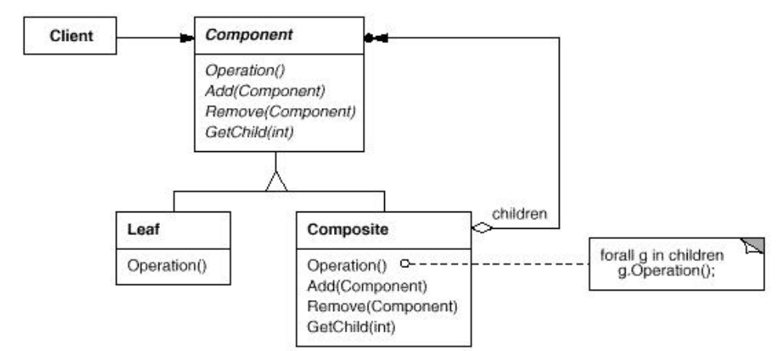
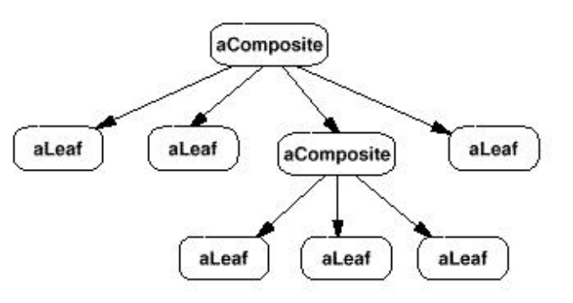
Composite Pattern
UML diagram:

Slide 9
Composite Pattern
Participants:
  Component
    declares the interface for objects in the composition.
    implements default behaviour for the interface common to all classes, as appropriate.
    declares an interface for accessing and managing its child components.
    may define an interface for accessing a component's parent in the recursive structure, and implements it if that's appropriate.
  Leaf
    represents leaf objects (no children) in the composition.
    defines behaviour for primitive objects in the composition.

Slide 10
Composite Pattern
Participants:
  Composite
    defines behaviour for components having children.
    stores child components.
    implements child-related operations in the Component interface.
  Client
    manipulates objects in the composition through the Component interface.
Collaborations:
  Clients use the Component class interface to interact with objects in the composite structure.
    If the recipient is a Leaf, then the request is handled directly.
    If the recipient is a Composite, then it usually forwards requests to its child components, possibly performing additional operations before and/or after forwarding.

Slide 11
Composite Pattern
Consequences:
  Benefits:
    Defines class hierarchies consisting of primitive objects and composite objects.
      Primitive objects can be composed into more complex objects, which in turn can be recursively composed into still more complex objects.
      Wherever client code expects a primitive object, it can also take a composite object.
    It makes it easy to add new kinds of components
      Newly defined Composite or Leaf subclasses work automatically with existing structures and client code.
      Clients don't have to be changed for new Component classes.
    It makes clients simpler, since they do not have to know if they are dealing with a leaf or a composite component
      This simplifies client code, avoiding having to write case statement style functions over the classes that define the composition.

Slide 12
Composite Pattern
Consequences:
  Liabilities:
    It can make your design overly general.
      The disadvantage of making it easy to add new components is that it makes it harder to restrict the components of a composite.
      Sometimes you want a composite to have only certain components.
      With Composite, you can't rely on the type system to enforce those constraints for you.
        Instead, you have to perform checks at run-time.

Slide 13
Composite Pattern
Implementation Issues:
  Explicit parent references:
    A composite object knows its contained components (children).
      Should components also maintain a reference to their parent component?
        Maintaining references from child components to their parent can simplify the traversal and management of a composite structure.
        The parent reference simplifies moving up the structure and deleting a component.
        Parent references also help support the Chain of Responsibility pattern.
        The usual place to define the parent reference is in the Component class.
        Leaf and Composite classes can then inherit the reference and the operations that manage it.

Slide 14
Composite Pattern
Implementation Issues:
  Explicit parent references:
    A composite object knows its contained components (children).
      Should components also maintain a reference to their parent component?
        With parent references, we need to enforce the constraint that all children of a composite have as their parent the composite that in turn has them as children.
        The easiest way to ensure this is to change a component's parent only when it's being added or removed from a composite.
        If this can be implemented once in the add() and remove() operations of the Composite class, then it can be inherited by all the subclasses, and the constraint will be automatically enforced.

Slide 15
Composite Pattern
Implementation Issues:
  Sharing components.
    It's often useful to share components to reduce storage requirements.
    But when a component can have no more than one parent, sharing components becomes difficult.
      A possible solution is for children to store multiple parents, but that can lead to ambiguities as a request propagates up the structure.
    The Flyweight pattern shows how to rework a design to avoid storing parents altogether.
    It works in cases where children can avoid sending parent requests by externalising some or all of their state.

Slide 16
Composite Pattern
Implementation Issues:
  Maximising the Component interface:
    One of the goals of the Composite pattern is to make clients unaware of the specific Leaf or Composite classes they're using.
      To achieve this goal, the Component class should maximise its interface by defining as many common operations for Composite and Leaf classes as possible.
      The Component class usually provides default implementations for these operations, which Leaf and Composite subclasses can override.
    However, this goal will sometimes conflict with the principle of class hierarchy design that says a class should only define operations that are meaningful to its subclasses.
    There are many operations that Component supports that don't seem to make sense for Leaf classes, so how can Component provide a default implementation for them?

Slide 17
Composite Pattern
Implementation Issues:
  Maximising the Component interface:
    Sometimes a little creativity shows how an operation that would appear to make sense only for Composites can be implemented for all Components by moving it to the Component class.
      For example, the interface for accessing children is a fundamental part of a Composite class but seems contradictory for a Leaf class.
      But if we view a Leaf as a Component that never has children, then we can define a default operation for child access in the Component class that never returns any children.
      Leaf classes can use the default implementation, but Composite classes will override the default implementation in order to return their children.

Slide 18
Composite Pattern
Implementation Issues:
  Where should the child management methods (add(), remove(), getChild()) be declared?
    In the Component class?:
      Gives transparency, since all components can be treated the same.
      But it's not safe, since clients can try to do meaningless things to leaf components at run-time.
    In the Composite class?:
      Gives safety, since any attempt to perform a child operation on a leaf component will be caught at compile-time.
      But we lose transparency, since now leaf and composite components have different interfaces

Slide 19
Composite Pattern
Implementation Issues:
  Should Component implement a list of Components?
    You might be tempted to define the set of children as an instance variable in the Component class where the child access and management operations are declared.
    But putting the child pointer in the base class incurs a space penalty for every leaf, even though a leaf never has children.
    This is worthwhile only if there are relatively few children in the structure.

Slide 20
Composite Pattern
Implementation Issues:
  Child ordering.
    Many designs specify an ordering on the children of Composite.
    In the earlier Graphics example, ordering might reflect front-to-back display ordering.
    As another example, if Composites are being used to represent parse trees, then compound statements can be instances of a Composite whose children must be ordered to reflect the program.
    When child ordering is an issue, you must design child access and management interfaces carefully to manage the sequence of children.
    The Iterator pattern can help you do this.

Slide 21
Composite Pattern
Implementation Issues:
  Caching to improve performance.
    If you need to traverse or search compositions frequently, the Composite class can cache traversal or search information about its children.
    The Composite can cache actual results or just information that lets it short-circuit the traversal or search.
    Changes to a component will require invalidating the caches of its parents.
    This works best when components know their parents.
    So if you're using caching, you need to define an interface for telling composites that their caches are no longer valid.

Slide 22
Composite Pattern
Implementation Issues:
  Who should delete components?
    In languages without garbage collection, it's usually best to make a Composite responsible for deleting its children when it's destroyed.
    An exception to this rule is when Leaf objects are immutable and thus can be shared.
  What's the best data structure for storing components?
    Composites may use a variety of data structures to store their children, including linked lists, trees, arrays, and hash tables.
      The choice of data structure depends on efficiency.
    In fact, it isn't even necessary to use a general purpose data structure at all.
      Sometimes composites have a variable for each child, although this requires each subclass of Composite to implement its own management interface.
      The Interpreter pattern provides an example of this.

Slide 23
Composite Pattern
Related Patterns
  Often the component-parent link is used for a Chain of Responsibility.
  Decorator is often used with Composite.
    When decorators and composites are used together, they will usually have a common parent class, so decorators will have to support the Component interface with operations like add(), remove(), and getChild().
  Flyweight lets you share components, but they can no longer refer to their parents.
  Iterator can be used to traverse composites.
  Visitor localises operations and behaviour that would otherwise be distributed across Composite and Leaf classes.

Slide 24
Composite Pattern – GUI Example
Example: A GUI system has window objects which can contain various GUI components (widgets) such as buttons and text areas.
A window can also contain widget container objects which can hold other widgets.
There are a number of possible solutions.
Solution 1: Design all the widgets with different interfaces for "updating" the screen
  The following is the update() method for the Window class.

Slide 25
Composite Pattern – GUI Example
public class Window {
Button[] buttons;
Menu[] menus;
TextArea[] textAreas;
WidgetContainer[] containers;
//...
public void update() {
  if (buttons != null) {
  for (int k = 0; k < buttons.length; k++)
  buttons[k].draw();
  if (menus != null)
  for (int k = 0; k < menus.length; k++)
  menus[k].refresh();
  //other widgets handled similarly.
  if (containers != null)
  for (int k = 0; k < containers.length; k++ )
  containers[k].updateWidgets();
  }
}
}

Slide 26
Composite Pattern – GUI Example
Not the best solution because if we want to add a new kind of widget, we have to modify the update() method of Window to handle it.
Solution 2: Make all widgets support a Widget interface, either by being subclasses of a Widget class or implementing a Widget interface.

Slide 27
Composite Pattern – GUI Example
  public class Window {
  Widget[] widgets;
  WidgetContainer[] containers;
  public void update() {
  if (widgets != null)
  for (int k = 0; k < widgets.length; k++)
  widgets[k].update();
  if (containers != null)
  for (int k = 0; k < containers.length; k++)
  containers[k].updateWidgets();
  }
  }
Still requires us to distinguish between widgets and widget containers.

Slide 28
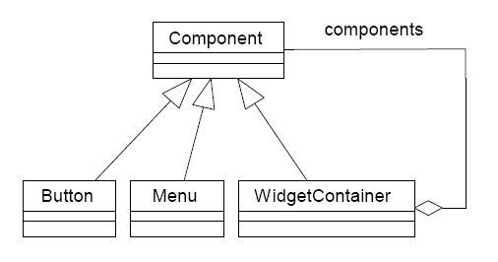
Composite Pattern – GUI Example
Solution 3: Use the composite pattern.
Class diagram:

Slide 29
Composite Pattern – GUI Example
  public class Window {
  Component[] components;
  public void update() {
  if (components != null)
  for (int k = 0; k < components.length; k++)
  components[k].update();
  }
  }

Slide 30
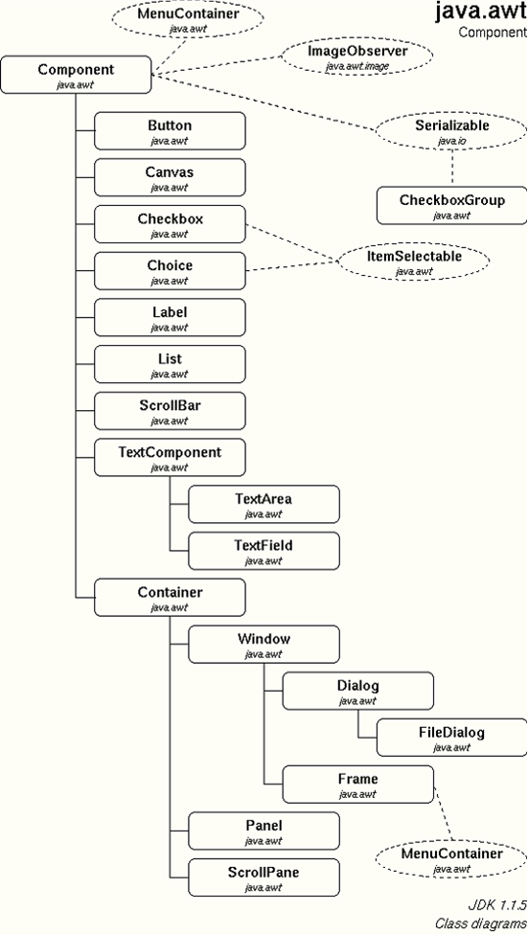
Composite Pattern – Java AWT

Slide 31
Composite Pattern Example
Folders and Directories
Modelling files and folders, a folder can contain other files and folders.
interface AbstractDirElement{
public void dir();
}
class File implements AbstractDirElement{
private String m_name;
public File(String name) {
this.name = name;
}
public void dir() {
System.out.println(name);
}
}

Slide 32
Composite Pattern Example
Folders and Directories
class Directory implements AbstractDirElement{
private String name;
private ArrayList<AbstractDirElement> files =
new ArrayList()<AbstractDirElement>;
public Directory(String name) { this.name = name; }
public void add(Object obj) { files.add(obj); }
public void dir() {
System.out.println(name);
for (int i=0; i < files.size(); ++i) {
AbstractDirElement obj = (AbstractDirElement) m_files.get(i);
obj.dir();
}
}
}

Slide 33
Composite Pattern Example
Folders and Directories
public class CompositeDirectoryDemo {
public static void main( String[] args ) {
AbstractDirElement root = new Directory("mydir");
AbstractDirElement dir2 = new Directory("dir2");
AbstractDirElement f1 = new File("myFile1.txt"),
AbstractDirElement f2 = new File("myFile2.txt "),
AbstractDirElement f3 = new File("myFile3.txt "),
root.add(f1);
root.add(dir2);
dir2.add(f2);
dir2.add(f3);
root.dir();
}
}

Slide 34
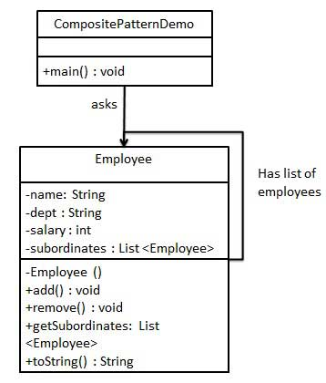
Composite Pattern Example
Example: Suppose we want to be able to store information about Employees, including the fact that an Employee may be the supervisor of many other Employees.
We might represent the class relationships like this:

Slide 35
Composite Pattern Example
The code for Employee looks like this:
import java.util.ArrayList;
import java.util.List;
public class Employee {
private String name;
private String dept;
private int salary;
private List<Employee> subordinates;
// constructor
public Employee(String name,String dept, int sal) {
this.name = name;
this.dept = dept;
this.salary = sal;
subordinates = new ArrayList<Employee>();
}
// continued on next slide

Slide 36
Composite Pattern Example
The code for Employee looks like this:
// continued from previous slide
public void add(Employee e) { subordinates.add(e); }
public void remove(Employee e) { subordinates.remove(e); }
public List<Employee> getSubordinates(){ return subordinates; }
public String toString(){
return ("Employee :[ Name : "+ name +", dept : "+ dept + ", salary :" +
salary+" ]");
}
}

Slide 37
Composite Pattern Example
Now we define a class to print out the employee hierarchy:
public class CompositePatternDemo {
public static void main(String[] args) {
Employee CEO = new Employee("John","CEO", 30000);
Employee headSales = new Employee("Robert","Head Sales", 20000);
Employee headMarketing = new Employee("Michel","Head Marketing", 20000);
Employee clerk1 = new Employee("Laura","Marketing", 10000);
Employee clerk2 = new Employee("Bob","Marketing", 10000);
Employee salesExecutive1 = new Employee("Richard","Sales", 10000);
Employee salesExecutive2 = new Employee("Rob","Sales", 10000);
CEO.add(headSales); CEO.add(headMarketing);
headSales.add(salesExecutive1); headSales.add(salesExecutive2);
headMarketing.add(clerk1); headMarketing.add(clerk2);
System.out.println(CEO);
for (Employee headEmployee : CEO.getSubordinates()) {
System.out.println(headEmployee);
for (Employee employee : headEmployee.getSubordinates()) {
System.out.println(employee);
}
} } }

Slide 38
Facade Pattern

Slide 39
Facade Pattern
The Facade pattern provides a simplified version of an existing interface to make use easier.
Examples of use for a Facade pattern:
  making a software library easier to use and understand, since the facade has convenient methods for common tasks;
  making code that uses the library more readable, for the same reason;
  reducing dependencies of outside code on the inner workings of a library, since most code uses the facade, thus allowing more flexibility in developing the system;
  wrapping a poorly designed collection of APIs with a single well-designed API.
An Adapter is used when our wrapper must respect a particular interface and must support a polymorphic behaviour.
On the other hand, a Facade is used when one wants an easier/simpler interface to work with.

Slide 40
Facade Pattern
The facade presents a unified interface to a set of interfaces in a subsystem.
It defines a higher-level interface that makes the subsystem easier to use.
Motivations for its use can include:
  Structuring a system into subsystems helps reduce complexity,
    Subsystems are groups of classes, or groups of classes and other subsystems.
    Most patterns, when applied, result in more and smaller classes.
    This makes the subsystem more reusable and easier to customise, but it also becomes harder to use for clients that don't need to customise it.
    A facade can provide a simple default view of the subsystem that is good enough for most clients.
    Only clients needing more customizability will need to look beyond the facade.

Slide 41
Facade Pattern
Motivations for its use can include:
  The interface exposed by the classes in a subsystem or set of subsystems can become quite complex.
    One way to reduce this complexity is to introduce a facade object that provides a single, simplified interface to the more general facilities of a subsystem.
  There are many dependencies between clients and the implementation classes of an abstraction.
    We can introduce a facade to decouple the subsystem from clients and other subsystems, thereby promoting subsystem independence and portability.
  If we want to layer our subsystems.
    We can use a facade to define an entry point to each subsystem level.
    If subsystems are dependent, then you can simplify the dependencies between them by making them communicate with each other solely through their facades.

Slide 42
Facade Pattern
Example: We might have a programming environment that gives applications access to its compiler subsystem.
This subsystem contains classes such as Scanner, Parser, ProgramNode, BytecodeStream, and ProgramNodeBuilder that implement the compiler.
Some specialized applications might need to access these classes directly, but most clients of a compiler generally don't care about details like parsing and code generation; they merely want to compile some code.
From their point of view, the powerful but low-level interfaces in the compiler subsystem only complicate their task.

Slide 43
Facade Pattern
To provide a higher-level interface that can shield clients from these classes, the compiler subsystem also includes a Compiler class which defines a unified interface to the compiler's functionality.
The Compiler class acts as a facade: It offers clients a single, simple interface to the compiler subsystem by gluing together the classes that implement compiler functionality without hiding them completely.
The Compiler facade makes life easier for most programmers without hiding the lower-level functionality from the few that do need it.

Slide 44
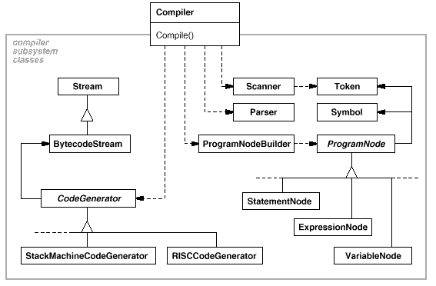
Facade Pattern

Slide 45
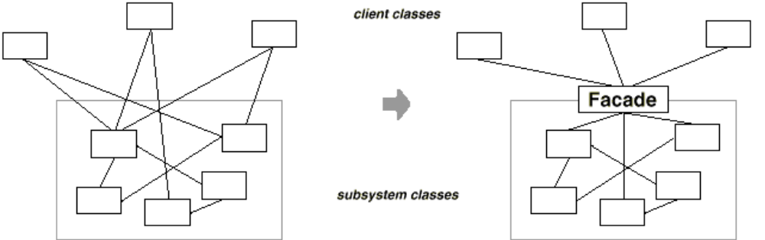
Facade Pattern
Simplified view of facade:

Slide 46
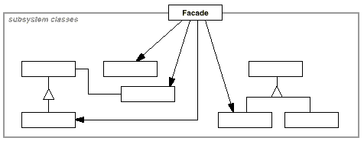
Facade Pattern
UML diagram:

Slide 47
Facade Pattern
Participants
  Facade
    knows which subsystem classes are responsible for a request.
    delegates client requests to appropriate subsystem objects.
  Subsystem classes
    implement subsystem functionality.
    handle work assigned by the Facade object.
    have no knowledge of the facade; that is, they keep no references to it.
Collaborations
  Clients communicate with the subsystem by sending requests to Facade, which forwards them to the appropriate subsystem object(s).
  Although the subsystem objects perform the actual work, the facade may have to translate its interface to the subsystem interfaces.
  Clients that use the facade don't have to access its subsystem objects directly.

Slide 48
Facade Pattern
Consequences:
  Benefits:
    It hides the implementation of the subsystem from clients, reducing the number of objects that the client deals with and making the subsystem easier to use.
    It promotes weak coupling between the subsystem and its clients.
      Subsystem components may themselves be strongly coupled.
      This allows you to change the classes that comprise the subsystem without affecting the clients.
    Facades help layer a system and the dependencies between objects and can eliminate complex or circular dependencies.
      This can be an important consequence when the client and the subsystem are implemented independently.
    It reduces compilation dependencies in large software systems.

Slide 49
Facade Pattern
Consequences:
  Benefits:
    It simplifies porting systems to other platforms, because it's less likely that building one subsystem requires building all others.
    It does not prevent sophisticated clients from accessing the underlying classes.
    Note that Facade does not add any functionality, it just simplifies interfaces.
  Liabilities:
    It does not prevent clients from accessing the underlying classes.

Slide 50
Facade Pattern
Implementation:
  Reducing client-subsystem coupling.
    The coupling between clients and the subsystem can be reduced even further by making Facade an abstract class with concrete subclasses for different implementations of a subsystem.
    Clients can then communicate with the subsystem through the interface of the abstract Facade class.
      This abstract coupling keeps clients from knowing which implementation of a subsystem is used.
    An alternative to subclassing is to configure a Facade object with different subsystem objects.
      To customise the facade, simply replace one or more of its subsystem objects.

Slide 51
Facade Pattern
Implementation:
  Public versus private subsystem classes.
    A subsystem is similar to a class in that both have interfaces, and both encapsulate something; a class encapsulates state and operations, while a subsystem encapsulates classes.
    We can follow the analogy by thinking of the public and private interface of a subsystem in the same way as we can think of the public and private interface of a class.
    The public interface to a subsystem consists of classes that all clients can access; the private interface is just for subsystem extenders.
    The Facade class is part of the public interface, of course, but it's not the only part, because other subsystem classes are usually public as well.
      For example, the classes Parser and Scanner in the compiler subsystem are part of the public interface.

Slide 52
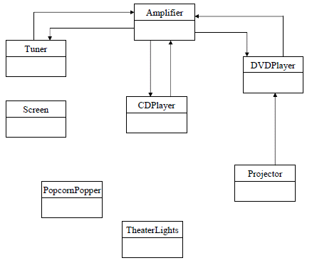
Facade Example – Home Theatre system
A lot of classes!!!

Slide 53
Home Theatre Facade
Turn on popcorn popper
Start popping
Dim the lights
Put the screen down
Turn the projector on
Set the projector input to DVD
Put the projector on wide-screen mode
Turn the sound amplifier on
...
...
Turn DVD player on
Start DVD player
popper.on();
popper.pop();
lights.dimm(20);
screen.down();
projector.on();
projector.setInput(dvd);
projector.wideScreenMode();
amp.on();
amp.setSurroundSound();
amp.setVolume(10);
amp.setDvd(dvd);
dvd.on();
dvd.play(movie);

Slide 54
Home Theatre Facade
public class HomeTheaterFacade {
Amplifier amp;
Tuner tuner;
DvdPlayer dvd;
CdPlayer cd;
Projector projector;
TheaterLights lights;
Screen screen;
PopcornPopper popper;

Slide 55
Home Theatre Facade
public HomeTheaterFacade(Amplifier amp,
        Tuner tuner,
        DvdPlayer dvd,
        CdPlayer cd,
        Projector projector,
        Screen screen,
        TheaterLights lights,
        PopcornPopper popper) {
  this.amp = amp;
  this.tuner = tuner;
  this.dvd = dvd;
  this.cd = cd;
  this.projector = projector;
  this.screen = screen;
  this.lights = lights;
  this.popper = popper;
  }

Slide 56
Home Theatre Facade
public void watchMovie(String movie) {
System.out.println("Get ready to watch a movie...");
popper.on();
popper.pop();
lights.dim(10);
screen.down();
projector.on();
projector.wideScreenMode();
amp.on();
amp.setDvd(dvd);
amp.setSurroundSound();
amp.setVolume(5);
dvd.on();
dvd.play(movie);
}
public void endMovie() { … }

Slide 57
Home Theatre Facade
public class HomeTheaterTestDrive {
public static void main(String[] args) {
    Amplifier amp = new Amplifier();
    Tuner tuner = new Tuner();
    //...instantiate all components
    HomeTheaterFacade homeTheater =
    new HomeTheaterFacade(amp, tuner, dvd, cd,
    projector, screen, lights, popper);
    homeTheater.watchMovie("The Santa Claus");
    homeTheater.endMovie();

Slide 58
Facade Pattern
Related Patterns
  Abstract Factory can be used with Facade to provide an interface for creating subsystem objects in a subsystem-independent way.
  Abstract Factory can also be used as an alternative to Facade to hide platform-specific classes.
  Mediator is similar to Facade in that it abstracts functionality of existing classes, but Mediator’s purpose is to abstract arbitrary communication between colleague objects, often centralising functionality that doesn't belong in any one of them.
    A mediator's colleagues are aware of and communicate with the mediator instead of communicating with each other directly.
    In contrast, a facade merely abstracts the interface to subsystem objects to make them easier to use; it doesn't define new functionality, and subsystem classes don't know about it.
  Usually only one Facade object is required, so Facade objects are often Singletons.

Slide 59
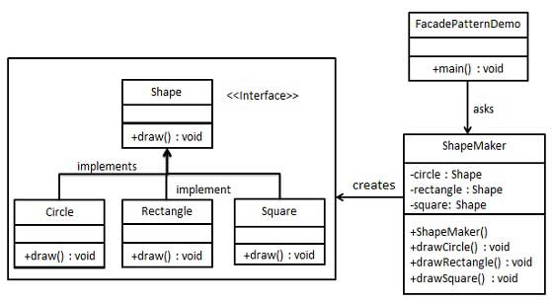
Facade Pattern Example
Example: We will create a Shape interface and a set of concrete classes that implement the interface.
A facade class ShapeMaker is then defined that uses the concrete classes to delegate user calls to these classes.
A driver class, FacadePatternDemo, will use ShapeMaker class to show the results.

Slide 60
Facade Pattern Example
We create the interface and the set of concrete classes:
public interface Shape { void draw(); }
public class Rectangle implements Shape {
public void draw() {
System.out.println("Rectangle::draw()");
}
}
public class Square implements Shape {
public void draw() {
System.out.println("Square::draw()");
}
}
public class Circle implements Shape {
public void draw() {
System.out.println("Circle::draw()");
}
}

Slide 61
Facade Pattern Example
Next we define our facade class:
public class ShapeMaker {
private Shape circle;
private Shape rectangle;
private Shape square;
public ShapeMaker() {
circle = new Circle();
rectangle = new Rectangle();
square = new Square();
}
public void drawCircle(){ circle.draw(); }
public void drawRectangle(){ rectangle.draw(); }
public void drawSquare(){ square.draw(); }
}

Slide 62
Facade Pattern Example
Now we get our client to use the facade class:
public class FacadePatternDemo {
public static void main(String[] args) {
ShapeMaker shapeMaker = new ShapeMaker();
shapeMaker.drawCircle();
shapeMaker.drawRectangle();
shapeMaker.drawSquare();
}
}

Slide 63
Bridge Pattern

Slide 64
Bridge Pattern
When an abstraction can have one of several possible implementations, the usual way to accommodate them is to use inheritance.
An abstract class defines the interface to the abstraction, and concrete subclasses implement it in different ways.
But this approach isn't always flexible enough.
Inheritance binds an implementation to the abstraction permanently, which makes it difficult to modify, extend, and reuse abstractions and implementations independently.

Slide 65
Bridge Pattern
Consider the implementation of a portable Window abstraction in a user interface toolkit.
There are several possible platforms:
  X Window System,
  IBM's Presentation Manager (PM), …
There can also be different kinds of windows: IconWindow, TransientWindow, etc.
We need to be able to extend Window with hierarchies in multiple dimensions.

Slide 66
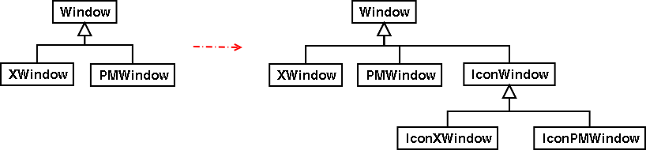
Bridge Pattern
The normal solution would be to adopt subclassing:
However, problems can arise:
  a combinatorial explosion in number of classes,
  difficulties in sharing of implementations,
  exposure of platform dependencies to clients.

Slide 67
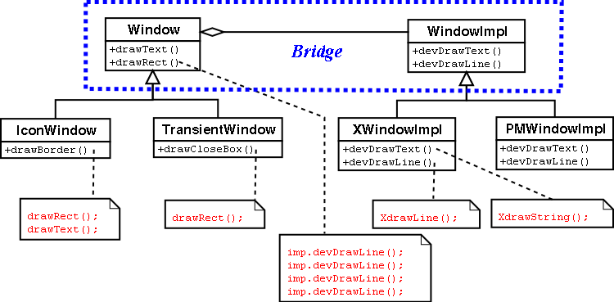
Bridge Pattern
The Bridge pattern gives us an alternative:

Slide 68
Bridge Pattern
Intent and Context:
  Bridge decouples an abstraction from its implementation so that the two can vary independently.
  You use Bridge when:
    you want to avoid a permanent binding between an abstraction and its implementation,
      This might be the case when the implementation must be selected or capable of being switched at run-time.
    both the abstractions and implementations need to be subclassed,
      Bridge allows you to combine the different abstractions and implementations and extend them independently.
    changes in the implementation should have no impact on clients (no recompilation).
      Implementation is hidden from clients.

Slide 69
Bridge Pattern
Intent and Context:
  You use Bridge when:
    you want to avoid a proliferation of classes caused by extension in multiple, orthogonal extensions,
    you want to share an implementation among multiple objects (perhaps using reference counting), and hide this fact from the client.
      A simple example is might be a String class in which multiple objects can share the same string representation.

Slide 70
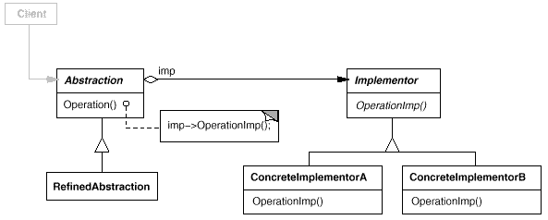
Bridge Pattern
UML diagram:

Slide 71
Bridge Pattern
Participants:
  Abstraction
    defines the abstraction’s interface
    maintains a reference to an object of type Implementor
  RefinedAbstraction
    extends the interface defined by Abstraction
  Implementor
    defines the interface for the implementation classes; doesn’t have to match interface of Abstraction
    typically Implementor provides only primitive operations, and Abstraction defines higher-level operations based on these primitives
  ConcreteImplementor
    implements the Implementor interface and defines its concrete implementation

Slide 72
Bridge Pattern
Collaborations
  Abstraction forwards client requests to its Implementor object.
Consequences:
  Improved extensibility.
    You can extend the Abstraction and Implementor hierarchies independently.
  Hiding implementation details from clients.
    You can shield clients from implementation details, like the sharing of implementor objects and the accompanying reference count mechanism (if any).

Slide 73
Bridge Pattern
Consequences:
  Decoupling interface and implementation.
    An implementation is not bound permanently to an interface.
      The implementation of an abstraction can be configured at run-time.
      It's even possible for an object to change its implementation at run-time.
    Decoupling Abstraction and Implementor also eliminates compile-time dependencies on the implementation.
    Changing an implementation class doesn't require recompiling the Abstraction class and its clients, which is essential when you must ensure binary compatibility between different versions of a class library.
    Furthermore, this decoupling encourages layering that can lead to a better-structured system.
    The high-level part of a system only has to know about Abstraction and Implementor.

Slide 74
Bridge Pattern
Implementation:
  There will only be one Implementor – the Abstraction-Implementor separation is still useful when a change in the implementation must not affect existing clients.
    In situations where there's only one implementation, creating an abstract Implementor class isn't necessary.
    This can be treated as a degenerate case of the Bridge pattern with a one-to-one relationship between Abstraction and Implementor.
    Nevertheless, this separation is still useful when a change in the implementation of a class must not affect its existing clients, so that they shouldn't have to be recompiled, just relinked.

Slide 75
Bridge Pattern
Implementation:
  Creating the right implementation object:
    How, when, where to decide on concrete implementation object?
    Abstraction knows about all concrete implementation classes:
      Parameterized constructor.
        If, for example, a collection class supports multiple implementations, the decision can be based on the size of the collection.
        A linked list implementation can be used for small collections and a hash table for larger ones.
      Default implementor.
        For example, if the collection grows bigger than a certain threshold, then it switches its implementation to one that's more appropriate for a large number of items.
    Another approach would be for an Abstract Factory object to be handled to the Abstraction constructor – abstraction is decoupled from all implementor classes.

Slide 76
Bridge Example
We can use the Bridge pattern to implement a Stack abstraction that lets us select one of several different implementations:
  linked list Stack,
  array-based Stack.

Slide 77
Bridge Example
This might be the abstraction of the Stack and the StackImpl interface:
public class Stack {
public Stack(String implType){
if (implType.equals("array")){
_impl = new ArrayBasedStack();
} else if (implType.equals("linkedlist")){
_impl = new LinkedListBasedStack();
}
}
public void push(Object o){ _impl.push(o); }
public Object pop(){ return _impl.pop(); }
public boolean isEmpty(){ return _impl.isEmpty(); }
public boolean isFull(){ return _impl.isFull(); }
private StackImpl _impl;
}
public interface StackImpl {
public void push(Object o);
public Object pop();
public boolean isEmpty();
public boolean isFull();
}

Slide 78
Bridge Example
An array-based implementation of Stack:
public class ArrayBasedStack implements StackImpl {
public void push(Object o){
if ( !isFull()){ _elements[++_size] = o; }
}
public boolean isEmpty(){ return (_size == -1); }
public boolean isFull(){
return (_size == MAX_SIZE-1);
}
public Object pop(){
if (isEmpty()){ return null; }
return _elements[_size--];
}
private final int MAX_SIZE = 100;
private Object[] _elements = new Object[MAX_SIZE];
private int _size = -1;
}

Slide 79
Bridge Example
An linked-list-based implementation of Stack:
public class LinkedListBasedStack implements StackImpl {
// use an inner class for linked list nodes
private class Node {
Node(Object o){
value = o; next = null; prev = null;
}
public Object value;
public Node next;
public Node prev;
public boolean isEmpty(){ return _tail == null; }
public boolean isFull(){ return false; }
public void push(Object o){
if (_tail == null){ _tail = new Node(o); }
else { _tail.next = new Node(o); _tail.next.prev = _tail; _tail = _tail.next;
}
}
public Object pop(){
if (isEmpty()) return null;
Object ret = _tail.value; _tail = _tail.prev; return ret;
}
private Node _tail;
}

Slide 80
Bridge Example
A client class:
public class Main {
public static void main(String[] args) {
Stack s = new Stack("linkedlist");
s.push("foo");
s.push("bar");
s.push("baz");
s.push("zip");
s.push("zap");
while (!s.isEmpty()){
System.out.println(s.pop());
}
}
}

Slide 81
Bridge Pattern
Related patterns:
  An Abstract Factory can create and configure a particular Bridge.
  Object Adapter and Bridge lead to code that looks quite similar.
    The Adapter pattern is geared toward making unrelated classes work together.
      It is usually applied to systems after they're designed.
    Bridge, on the other hand, is used up-front in a design to let abstractions and implementations vary independently.

Slide 82
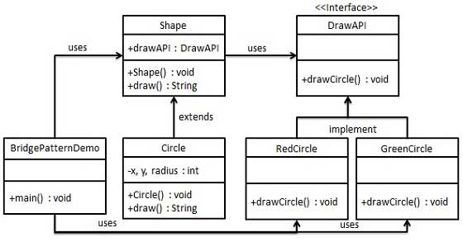
Bridge Pattern Example
Example: We have a DrawAPI interface which acts as a bridge implementer and a set of concrete classes RedCircle and GreenCircle which implement the DrawAPI interface.
Shape is an abstract class and will use an object of DrawAPI.
BridgePatternDemo, our driver class, will use the Shape class to draw different coloured circles.

Slide 83
Bridge Pattern Example
We begin with our bridge implementer interface and a set of concrete classes that implement it:
public interface DrawAPI {
public void drawCircle(int radius, int x, int y);
}
public class RedCircle implements DrawAPI {
public void drawCircle(int radius, int x, int y) {
System.out.println("Drawing Circle[ color: red, radius: " + radius +", x: "
+x+", "+ y +"]");
}
}
public class GreenCircle implements DrawAPI {
public void drawCircle(int radius, int x, int y) {
System.out.println("Drawing Circle[ color: green, radius: " + radius +", x: "
+x+", "+ y +"]");
}
}

Slide 84
Bridge Pattern Example
Now we create an abstract class Shape using the DrawAPI interface and a concrete class that implements Shape:
public abstract class Shape {
protected DrawAPI drawAPI;
protected Shape(DrawAPI drawAPI){ this.drawAPI = drawAPI; }
public abstract void draw();
}
public class Circle extends Shape {
private int x, y, radius;
public Circle(int x, int y, int radius, DrawAPI drawAPI) {
super(drawAPI);
this.x = x; this.y = y;
this.radius = radius;
}
public void draw() {
drawAPI.drawCircle(radius,x,y);
}
}

Slide 85
Bridge Pattern Example
Finally we create our driver class:
public class BridgePatternDemo {
public static void main(String[] args) {
Shape redCircle = new Circle(100,100, 10, new RedCircle());
Shape greenCircle = new Circle(100,100, 10, new GreenCircle());
redCircle.draw();
greenCircle.draw();
}
}

